Slide 1
Object Oriented Method && C++ Program Design -- Syllabus
Shengfa Wang
sfwang@dlut.edu.cn
Notes:
Syllabus 教学大纲

Slide 2
General Information
Shengfa Wang (王胜法) Associate Professor
Contact: sfwang@dlut.edu.cn
Office room: Information Building-317
Homepage: http://faculty.dlut.edu.cn/sfwang/zh_CN/index.htm
Teaching assistant ：张文怀：905099027 （QQ）
钟云彩：614806283（QQ）
Class Schedule:
64hours (32 talks + 24 practices)
Talks: 1-8 of Mon. and wed.
Practices: ?
Examination
item | ratio
Attendance & Practices | 30%
Final Examination | 70%

Slide 3
Goal by the end of the semester
Given a data source and a problem description, you can independently write a complete, useful program to solve the problem

Slide 4
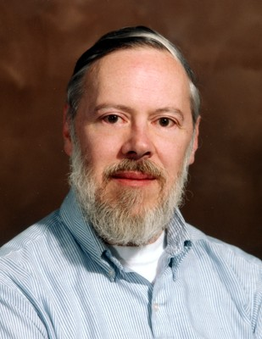
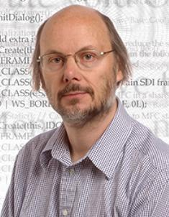
Prerequisites
C programming language is a mandatory prerequisite.
Why C++？
C++ Rulez!
C Rulez!
Dennis Ritchie
Bjarne Stroustrup
Notes:
C 语言： 把大象放进冰箱 。 （1） 打开冰箱门 （2）把大象放进去 （3） 关上冰箱门。
c++的版本就会比较多了： 第一种 ：（1）打开冰箱门 （2）把大象放进去 （3） 关上冰箱门。 第二种 ：首先定义冰箱类 ：包含三个方法 （1）开门 （2）关门 （3）放置（参数是大象）然后 定义大象类。接下来，构建大象和冰箱对象，然后调用开门方法 ，放置，最后关门。 第三种 ：定义一个容器类 ：包含三个方法 （1）打开容器 （2）放入物品 （3）关闭容器 。然后定义物品类。接着定义冰箱类作为容器的继承者继承所有功能，定义大象继承物品所有功能。接下来你就可以像把物品放入容器一样将大象放进冰箱了。以后你可以用容器类和物品类来解决将猴子放进烤箱，将老虎关进笼子等等。 第四种 ：定义模板类，包含三种模板方法 （1）初始化各种准备条件 （2）对于动作的双方调用某种动作方法 （3）清理现场。然后将第三种方法定义的类和放置方法传递给模板就能完成将大象放进冰箱或者将老虎关进笼子的工作了。

Slide 5
Is C++ the final weapon for us?
Notes:
学计算数学，是否matlab就够用了？
问高年级的同学，都说是！

Slide 6
Why teaching C++
Most common for research, and some areas of industry.
Java and Python are not suitable for learning algorithms and data structures.
Lisp maybe better than C++ for leaning algorithms and data structures. But it is not so common and limited in research field.
Matlab is better for research, but sometimes c & c++ is still a necessary complement.
The most of libraries for science computation are still implemented in C++.
Java is not, generally, a hard enough programming language that it can be used to discriminate between great programmers and mediocre programmers.

Slide 7
Programming language & Thought
Assembly language
Computation: Fortran 1954
System programming: C 1969, C++ 1979, C# 1999, Objective-C
Application: Java 1995, Java script, PHP
Unix shell to everything: Perl, Python, Ruby
Computation: Matlab, Mathematics, Mapple, R
The"concept"of"programming"languages"are"quite"similar"
Language is the dress of thought.
~Samuel Johnson
But if thought corrupts language, language can also corrupt thought.
~George Orwell
Notes:
Assembly language 汇编语言
Corrupt 腐蚀
“落霞与孤鹜齐飞 ，秋水共长天一色”出自唐朝王勃所作《滕王阁序》
Fortran: first widely used high level general purpose programming language, 1954
Basic language (Visual Basic .Net), 1964, emphasizes ease of use
C: 1969 -1973, system programming language for Unix, remains popular
C++: 1979 - 1998,
Java: 1995, "write once, run anywhere"
C#: 1999
Java script, PHP
Perl, Python, Ruby
Matlab, Mathematics, Mapple
A Unix shell is a command-line interpreter or shell that provides a traditional Unix-like command line user interface.

Slide 8
Evolution of Programming Languages
http://web.cs.hacettepe.edu.tr/~bbm101

Slide 9
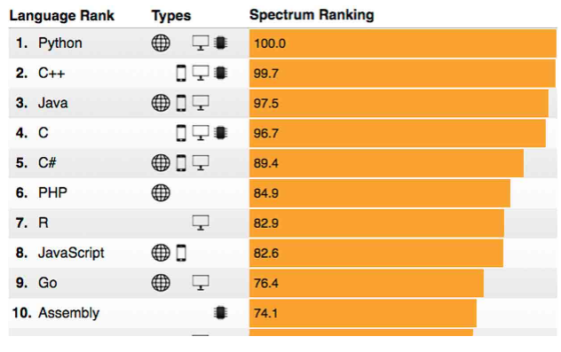
The 2018 Top Programming Languages
http://blog.codeeval.com/codeevalblog/2015

Slide 10
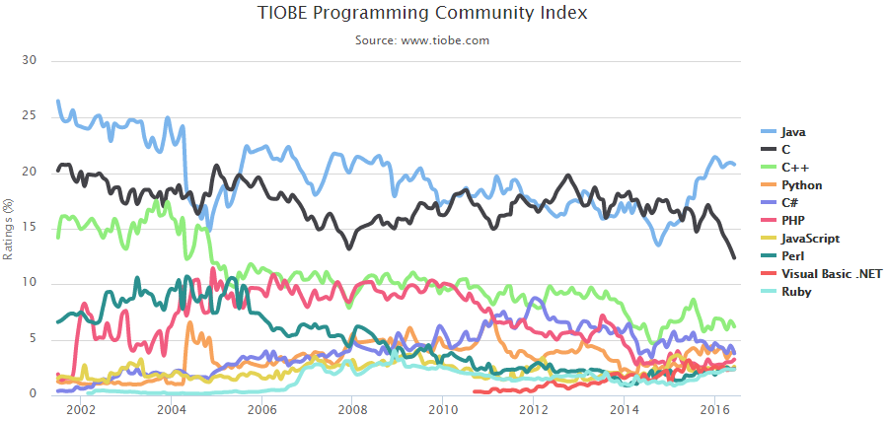
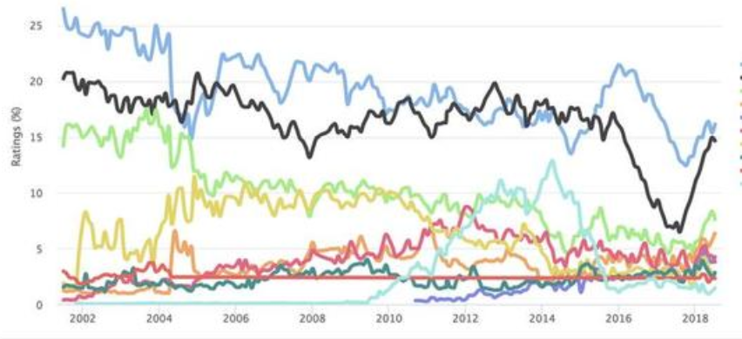
Notes:
TIOBE排行榜是根据互联网上有经验的程序员、课程和第三方厂商的数量，并使用搜索引擎（如Google、Bing、Yahoo!）以及Wikipedia、Amazon、YouTube统计出排名数据，只是反映某个编程语言的热门程度

Slide 11
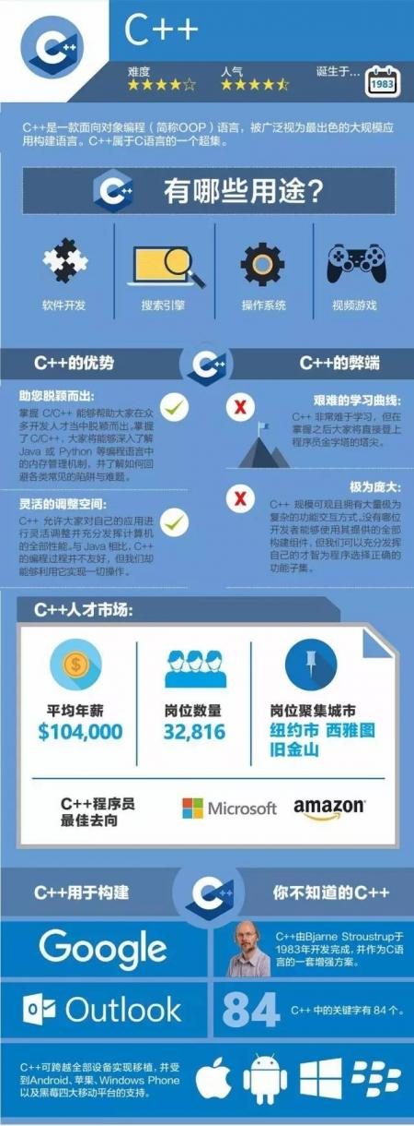
Notes:
TIOBE排行榜是根据互联网上有经验的程序员、课程和第三方厂商的数量，并使用搜索引擎（如Google、Bing、Yahoo!）以及Wikipedia、Amazon、YouTube统计出排名数据，只是反映某个编程语言的热门程度

Slide 12
How to Succeed?
Every one of you can succeed
Little, even without programming background is acceptable
There is no such thing as a “born programmer”
Work hard
Follow directions
Be methodical: Think before you act
Try on your own, then ask for help
Start early
Practice! Practice! Practice!
Course, book, web, other…
Notes:
鸡汤
童叟无欺

Slide 13


Research and Interview Oriented
Scientist (thesis + research)
IT, even other job (interview + work)
Notes:
50% 读研
考研录取率小于：1:5

Slide 14
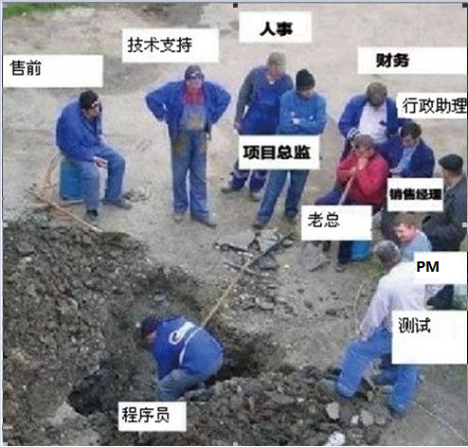

程序员 vs 程序猿
Notes:
接管家族产业

Slide 15
Contents
Introduction to Programming and OOP (Chap1)
Types and objects (First glimpse of OOP)
Input and output (int, string, cin/cout, <</>>, Chap3.1, 3.3)
Vector (Chap 4.6)
Errors (Chap 5, self-reading)
Writing a program (Principles of programming, Chap6-7)
*Technicalities (Details, Chap 9)
Graphics class design (Chap12-14): Hierarchies, encapsulation, and polymorphism.
Vector revisit (Chap 17-18): pointers and (copy) constructors
*Templates, containers and iterators (Chap19-20)

Slide 16
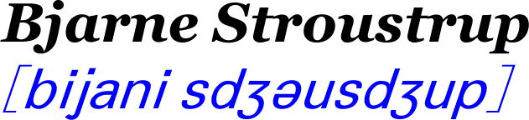

More
Created in 1979 by (Extensions to C)
Console programs is much easy and more portable than graphical programs
Notes:
Portable 轻便

Slide 17
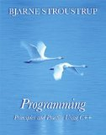
Textbooks
Programming: Principles and Practice Using C++ by Bjarne Stroustrup (ISBN: 978-7-111-28248-8)
Notes:
<<The C++ Programming Language>> , Bjarne Stroustrup 这是一本每个人都应该买但不一定要看的书，强烈建议初学者不要看这本书，有些晦涩难懂，但是买一本放在书柜里，有什么不清楚的地方查查高人如何解析还是有必要的。
《C++ Primer》 此书也被评为C++的最佳入门书籍，全书可谓是C++大全，深度适当，比较适合初学者。

Slide 18
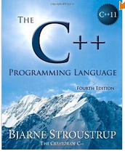
References: [Optional]
The C++ Programming Language by Bjarne Stroustrup
— Bible
Not recommended for a complete beginner.
Notes:
<<The C++ Programming Language>> , Bjarne Stroustrup 这是一本每个人都应该买但不一定要看的书，强烈建议初学者不要看这本书，有些晦涩难懂，但是买一本放在书柜里，有什么不清楚的地方查查高人如何解析还是有必要的。
《C++ Primer》 此书也被评为C++的最佳入门书籍，全书可谓是C++大全，深度适当，比较适合初学者。

Slide 19
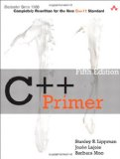
References: [Recommended]
C++ Primer (5th Edition) by S. B. Lippman, J. Lajoie, B. E. Moo （or 中文版）
Notes:
<<The C++ Programming Language>> , Bjarne Stroustrup 这是一本每个人都应该买但不一定要看的书，强烈建议初学者不要看这本书，有些晦涩难懂，但是买一本放在书柜里，有什么不清楚的地方查查高人如何解析还是有必要的。
《C++ Primer》 此书也被评为C++的最佳入门书籍，全书可谓是C++大全，深度适当，比较适合初学者。

Slide 20
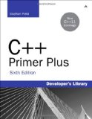
References: [Optional]
C++ Primer Plus by Stephen Prata

Slide 21
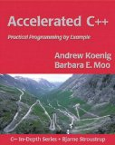
References: [Optional]
Accelerated C++: Practical Programming by Example by Andrew Koenig
Not recommended for a complete beginner.

Slide 22
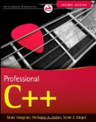
References: [Optional]
Professional C++ by M. Gregoire, N. A. Solter, S. J. Kleper 2nd edition
This book can be used in pair with one of the above, if you want to learn the new C++11 syntax. Not recommended for a complete beginner.

Slide 23
Useful Links
http://www.cplusplus.com
http://blog.csdn.net/u010309804/article/details/77075308
* http://www.runoob.com/cplusplus/cpp-basic-syntax.html

